Slide 1
Web Engineering
Muddiest Points and Class Recap 09.12.2015

Slide 2
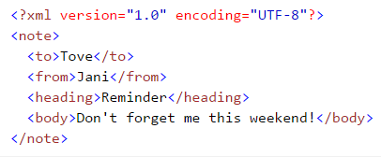

XML – Extensible Markup Language

Slide 3
HTML vs. XHTML
XHTML stands for EXtensible HyperText Markup Language
XHTML is almost identical to HTML
XHTML is stricter than HTML
XHTML is HTML defined as an XML application
XHTML is supported by all major browsers

Slide 4
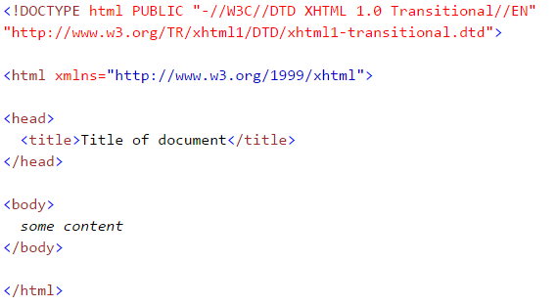
XHTML: <!DOCTYPE ....> Is Mandatory

Slide 5
XHTML: Elements Must Be Properly Nested
Wrong
Correct

Slide 6


XHTML: Elements Must Always Be Closed
Wrong
Correct

Slide 7


XHTML: Empty Elements Must Be Closed
Wrong
Correct

Slide 8


XHTML: Elements Must Be In Lower Case
Wrong
Correct

Slide 9
XHTML: Attribute Values Must Be Quoted
Wrong
Correct

Slide 10
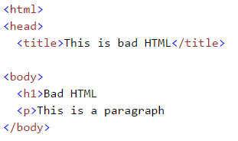
Why XHTML?

Slide 11
What is a DTD?
DTD is a Document Type Definition.
DTD defines the structure and the legal elements and attributes of SGML family markup language (such as XML and HTML).

Slide 12
What is a DTD?
The < !DOCTYPE > declaration is not an HTML tag.
It is an instruction to the web browser about what version of HTML the page is written in.
The DTD specifies the rules for the markup language, so that the browsers render the content correctly.

Slide 13
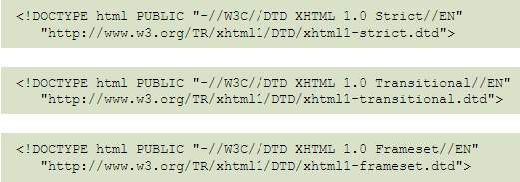
How is a DTD dealt with by a browser?

Slide 14
Why is there no DTD reference in HTML5?
HTML 4.01
HTML5
HTML5 is not based on SGML, and therefore does not require a reference to a DTD.

Slide 15
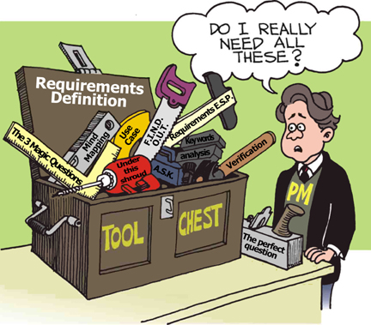
Website Requirements
Website requirements are a list of necessary functions, capabilities, or characteristics related to the website and the plans for creating it.

Slide 16
Functional vs. Non-Functional
Functional Requirements – What?
Non-Functional Requirements – How?

Slide 17

Car Shop: Functional Requirements
Web application shall accept customer orders and requests
It shall offer a customer registration option
It shall have a car search functions and search filter options

Slide 18
Car Shop: Non-Functional Requirements
Shall be easy to use
Shall be available in several languages
Shall allow several sales to be made at the same time without downgrading performance

